Slide 1


[SOCIAL BUZZ ANALYSIS]

Slide 2


Today's agenda
Project recap
Problem
The Analytics team
Process
Insights
Summary

Slide 3

Social Buzz is a fast growing technology unicorn that need to adapt quickly to its global
scale.
Accenture has begun a 3 month POC focusing o these tasks
“
1. An Audit of Social Buzz’s big data practice
2. Recommendations for Successful IPO
3. Analysis to find Social Buzz’s top 5 most popular categories of content.
Project Recap

Slide 4


Over 100000 posts per day
36,500,000 pieces of content per year
Analysis to find Social Buzz’s top 5 most popular categories of content.
Problem

Slide 5



The Analytics team

Slide 6
Process
1 Data Understanding
2 Data Cleaning
3 Data Modelling
4 Data Analysis
5 Uncover insight

Slide 7

Insights
16
Unique
Categories
1897
Reactions to “Animal”
Posts
JANUARY
Month with most posts

Slide 8
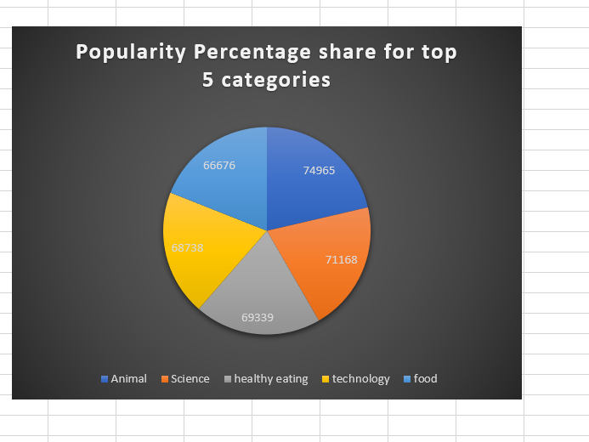

Slide 10

ANALYSIS
Animal and Science are the two most popular categories of content , this shows that people prefer or enjoy Animal related content and science related content
INSIGHTS
Food is the 5th most popular category of content with healthy Eating rank 3rd. This is a pointer to the fact that people loves to eat food that are healthy.
The company can collaborate with brands that offer healthy food and boost user engagement
Summary
NEXT ACTION
This adhoc analysis is insightful and it is time to take the analysis to a large scale production for real time understanding of your business. We can show you how to go about it!!!

Slide 11

Thank you!
ANY QUESTIONS?

